Slide 1
More than words
CSS Day, Amsterdam 2023
Léonie Watson

Slide 2
Hello!

Slide 3

Recognition

Slide 4
Implementation

Slide 5


In the cloud
Home assistants
Cloud-based applications

Slide 6

On device
Web readers
Screen readers

Slide 7
Synthetic speech

Slide 8
Formant TTS
Formant synthesis is rule based. The acoustic characters of speech are extracted from a voice recording, then programmed as rules for recreating the voice as digital audio.

Slide 9
Concatenative TTS
Concatenative synthesis uses a voice recording that's broken down into tiny chunks. The chunks are then reconstructed from a database to form the synthesized speech.

Slide 10
Parametric TTS
Parametric synthesis uses a statistical model. The parameters of speech are extracted from a voice recording, then Hidden Markov Models (HMM) modify the parameters based on the text to be spoken.
Notes:
Traditional TTS uses rule-based or statistical techniques, dependent on pre-defined linguistic and acoustic models, with a two step process:
1. Linguistic analysis
2. Acoustic production

Slide 11
Neural TTS
Neural TTS uses artificial neural networks trained on huge amounts of voice data. The neural networks learn the relationships between text and speech, and the result is voices that sound very close to human speech.
Notes:
Neural (NTTS) uses a single end-to-end process that's trained on vast amounts of speech data.

Slide 12
Clones
Neural TTS can transfer the prosodic characteristics of one voice to another, making it possible to synthesize speech in the voice of a particular speaker (with comparatively little individual training data).

Slide 13
In the cloud

Slide 14

Speech Synthesis Markup Language (SSML)
https://w3.org/TR/speech-synthesis/

Slide 15
The <voice> element
let responsePrompt = `<voice name='Brian'>
<s>Piglet sidled up to Pooh from behind.</s>
</voice>`;

Slide 16
The <prosody> element
let responsePrompt =
`<voice name=‘Brian’>
<s><prosody pitch='x-high' rate=‘medium’ volume='soft'>'Pooh'</prosody> he whispered.</s>
</voice>`;

Slide 17
The <break> element
let responsePrompt =
`<voice name='Brian’>
<s><prosody pitch='x-high’ rate=‘x-fast’>
Nothing</prosody>
said Piglet, taking Pooh's paw.
<break time='500ms'/></s>
</voice>`;

Slide 18
The <emphasis> element
let responsePrompt =
`<voice name='Brian'>
<s><prosody pitch='x-high' rate='x-fast'>
'I just wanted to be <emphasis level='strong'>sure</emphasis> of you'.</prosody></s>
</voice>`;

Slide 19
The whole story
Piglet sidled up to Pooh from behind.
Pooh! he whispered.
Yes Piglet?
Nothing, said Piglet, taking Pooh's paw.
I just wanted to be sure of you.

Slide 20
On the web

Slide 21
The CSS Speech module
https://w3.org/TR/css-speech-1/

Slide 22

Browser implementations

Slide 23
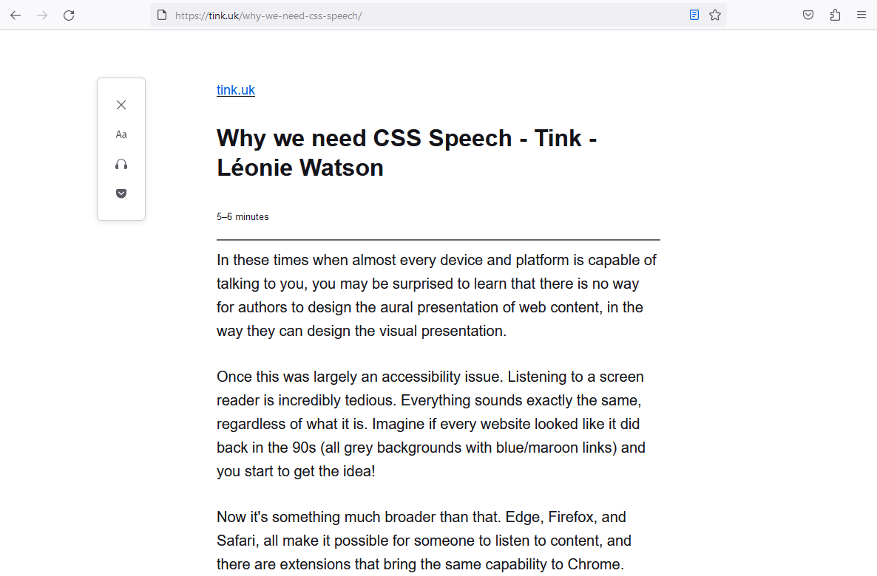
Use case 1: web readers

Slide 24
The voice-family property
voice-family: “Voice Name 1”, “Voice Name 2”;
https://speech-api-voices-gatherer.glitch.me/
Notes:
Takes the names of available voices in preference order.

Slide 25
The speak property
{speak: auto;}
Notes:
Other values are never and always.

Slide 26
The prosody properties
{
voice-volume: normal;
voice-pitch: normal;
voice-rate: normal;
}
Notes:
Other voice-volume values are x-soft, soft, medium, loud, x-loud.
Other voice-pitch properties are x-low, low, medium, high, x-high.
Other voice-rate values are: x-slow, slow, medium, fast, x-fast.

Slide 27
The pause properties
{
pause-before: medium;
pause-after: medium;
}
Notes:
Other pause-before and pause-after properties are none, x-weak, weak, strong, x-strong.

Slide 28
Design outcome 1: better UX

Slide 29
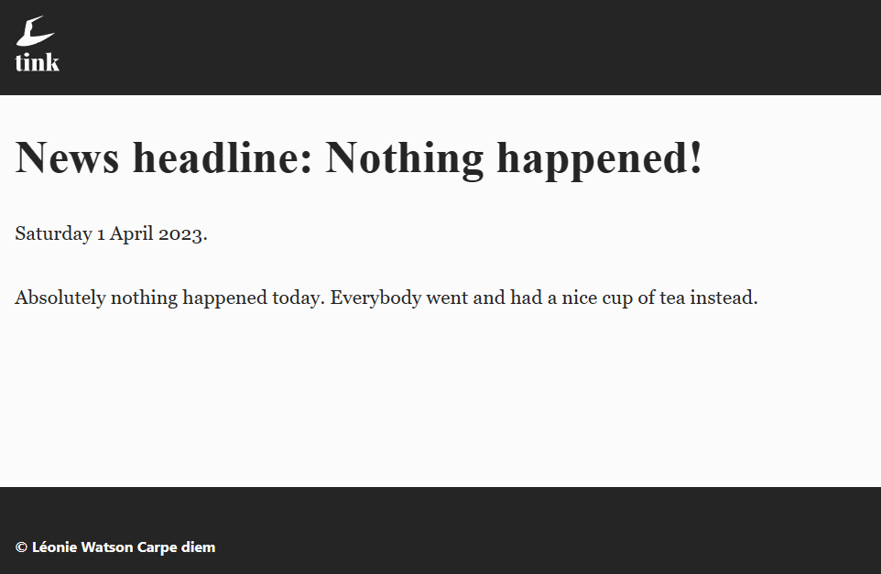
Use case 2: screen readers

Slide 30
The <em> element
<p>
If you <em>really</em> want to make a point.
</p>

Slide 31
The voice-stress property
.emphasise {
voice-stress: strong;
}
<p>
If you <em class="emphasise">really</em> want to make a point.
</p>
Notes:
The other voice-stress values are strong, moderate, none, reduced.
The other voice-range values are x-low, low, high, x-high.

Slide 32
Acronyms and initialisms
<p>Acronyms like NATO are pronounced like words, but initialisms like SAAS or AR are pronounced as individual characters.</p>

Slide 33
The speak-as property
.spell {
speak-as: spell-out;
}
<p class=“spell”>SAAS</p>
Notes:
Other say-as values are digits, literal-punctuation, no-punctuation.

Slide 34
Design outcome 2: better UX

Slide 35
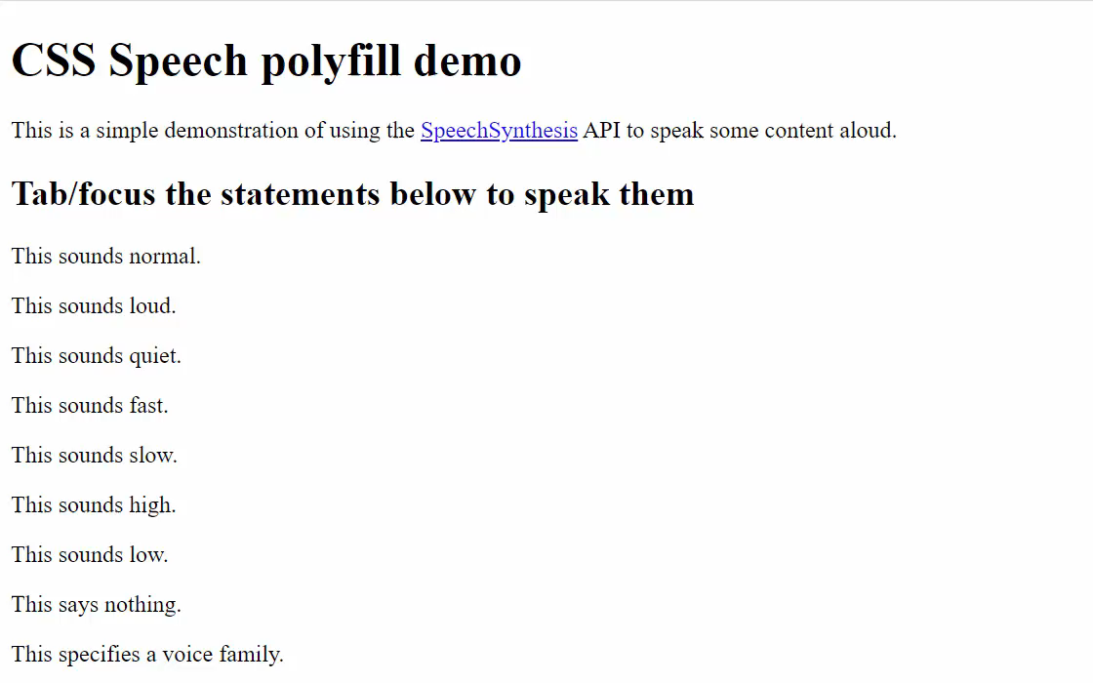
CSS Speech polyfill
https://www.kryogenix.org/code/browser/css-speech-polyfill/css-speech.html
Notes:
Created in collaboration with Stuart Langridge @sil@mastodon.social.

Slide 36





A new setting?

Slide 37
A call to action
Show your support for CSS Speech:
https://tink.uk/why-we-need-css-speech/

Slide 38
Thank you!
CSS Day, Amsterdam 2023

